Slide 1
Open Source and SAS Integration: Overview
Qing Liu
2017-06-16

Slide 2
Outline
About open source
R and Python
Integrating R in SAS
Integrating SAS in Python

Slide 3
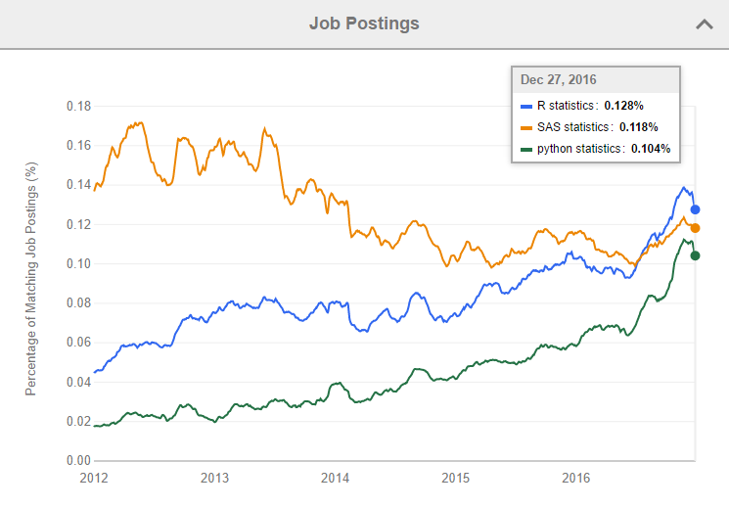
Job Trends for SAS, R, Python (from indeed.com)

Slide 4
Integrating R in SAS

Slide 5
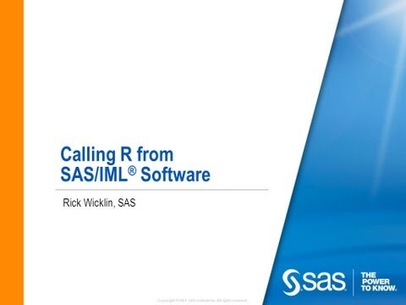
Calling R from SAS

Slide 6
Requirements
SAS/IML(SAS9.3 Above)
R
Change SAS Configuration:
-RLANG
-SET R_HOME “R location in your computer"

Slide 7
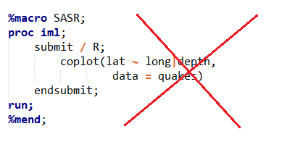
Warning
Do not put R program in SAS Macro:
Because % sign in R is a operator sign
But in SAS it’s a Macro invoker sign

Slide 8
Intergrating SAS in Python

Slide 9
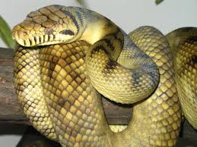


What is Python?

Slide 10
What is Python?
Python is a widely used high-level programming language for general-purpose programming like C, JAVA
Web Development
Software Development
Education
Scientific and Numeric
Python is a statistical programming language like SAS, R

Slide 11
Use Python code to access SAS
Video

Slide 12
Python Demo

